Slide 1

Identifying Key Performance Factors in Rocket League
Jacob Knodle and Caaden Rath

Slide 2
Research Questions
What are the most important factors a team should focus on to improve their likelihood of achieving a high win percentage?
Can we develop a regression model to predict the win percentage based on various performance factors?
How do performance statistics change across different divisions?
Notes:
Caaden

Slide 3
Motivation
Address how teams can improve their performance
Present results back to Dakota Collegiate Rocket League
Notes:
Caaden

Slide 4
Population Data
Population of Interest: Teams from across the 5-divisions within the Dakota Collegiate Rocket League (43 total teams)
Data Source: Data was obtained from post-game statistics for league sanctioned matches only (all games where between two teams from within the same league and division)
Experimental Units: An individual experimental unit was a single team
Notes:
Caaden

Slide 5
Response and Explanatory Variables
Response Variable: Win Percentage (Quantitative)
Explanatory Variables:
Quantitative:
Goals/Game
Goals Against/Game
Shots/Game
Shots Against/Game
Shooting Percentage
Assists/Game
Save Percentage
Demos/Game
Demos Against/Game
Ordinal:
Division
Notes:
Caaden

Slide 6
Graphical Methods
Scatterplots:
Allows for visualization of relationship between two variables
Correlation Matrix:
Identifies potential multicollinearity between variables
Residual Plots:
Scatterplot
Histogram
QQ Plot
Density Plot
Can help see distribution of data
Shows potential relationships between variables (both explanatory and response)
Notes:
Go over each plot type

Slide 7
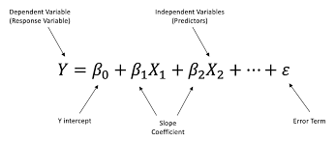
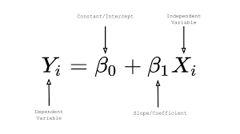
Numerical Methods and Inferential Methods
Numerical Methods:
Summary Statistics:
Mean
Median
Mode
IQR
Inferential Methods:
Modeling:
Simple Linear Regression:
Examines relationship between each individual independent variable and the response
Multiple Linear Regression:
Prediction equation
Hypothesis Testing
R and RStudio were used for graphical and numerical analysis
Notes:
Mention both types of regression and hypothesis testing for statistical significance. Also mention base model for simple andmultiple

Slide 8
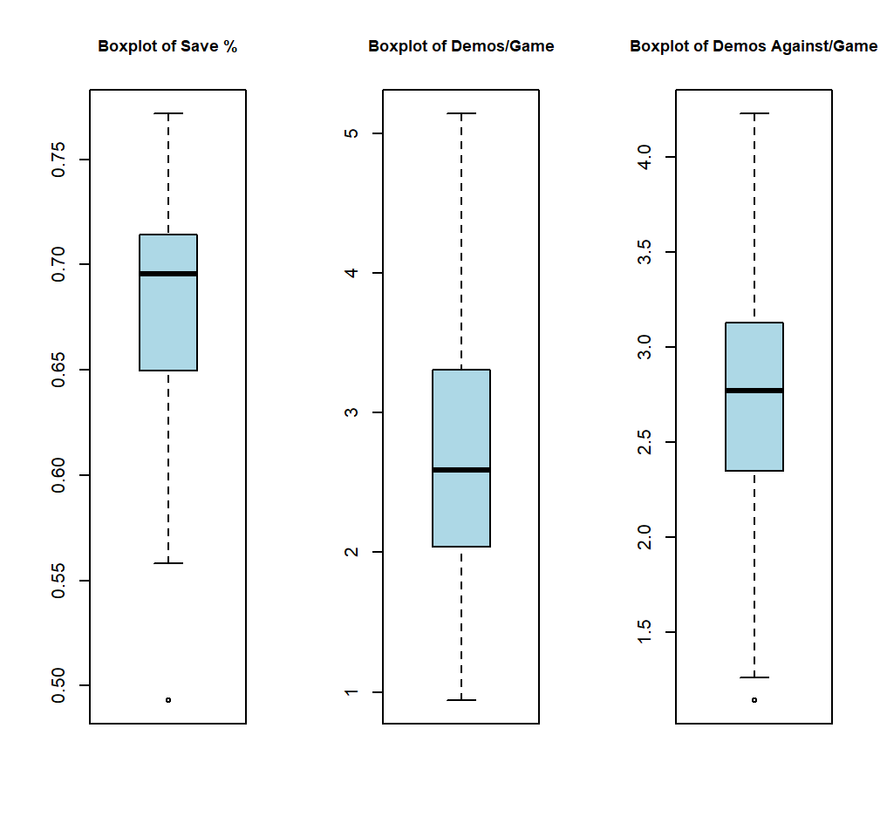
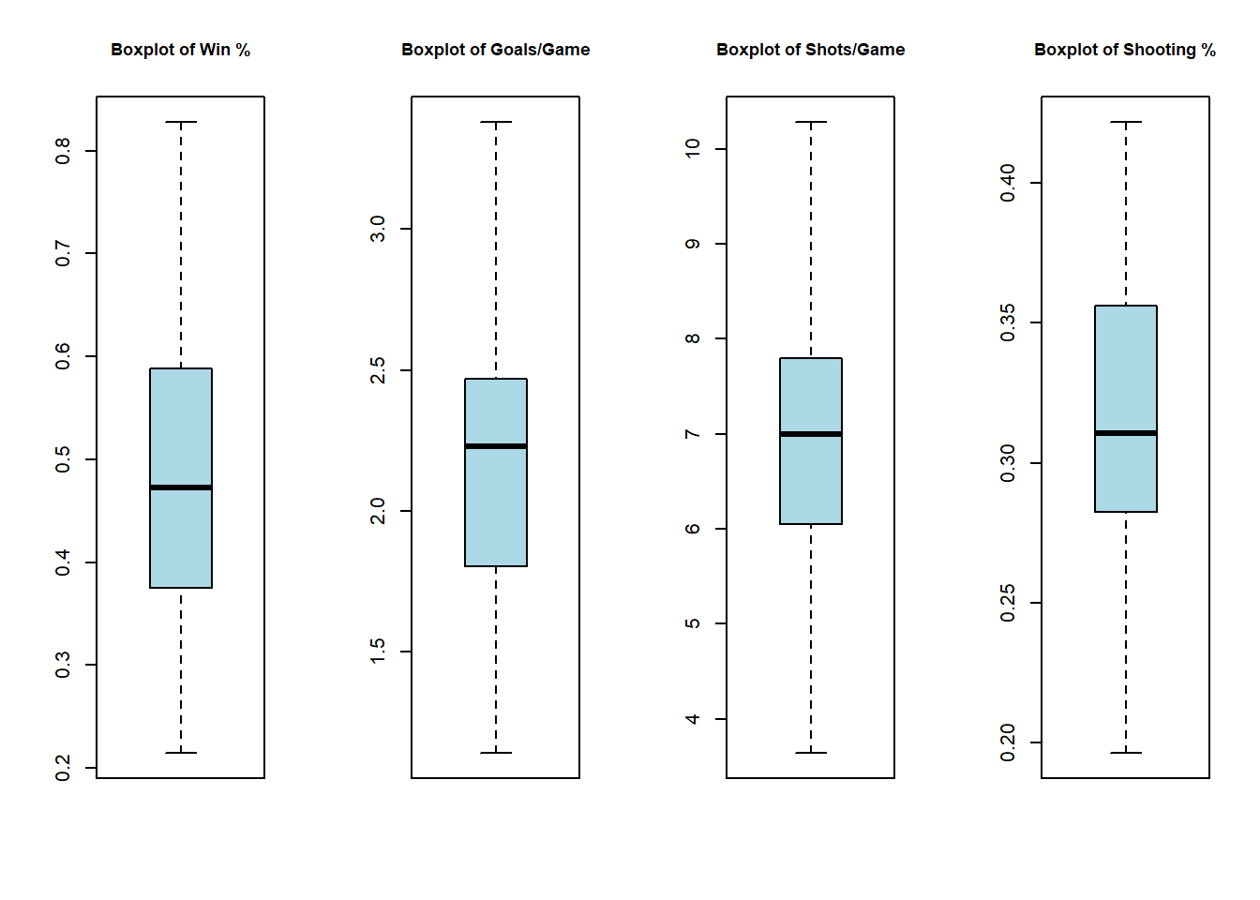
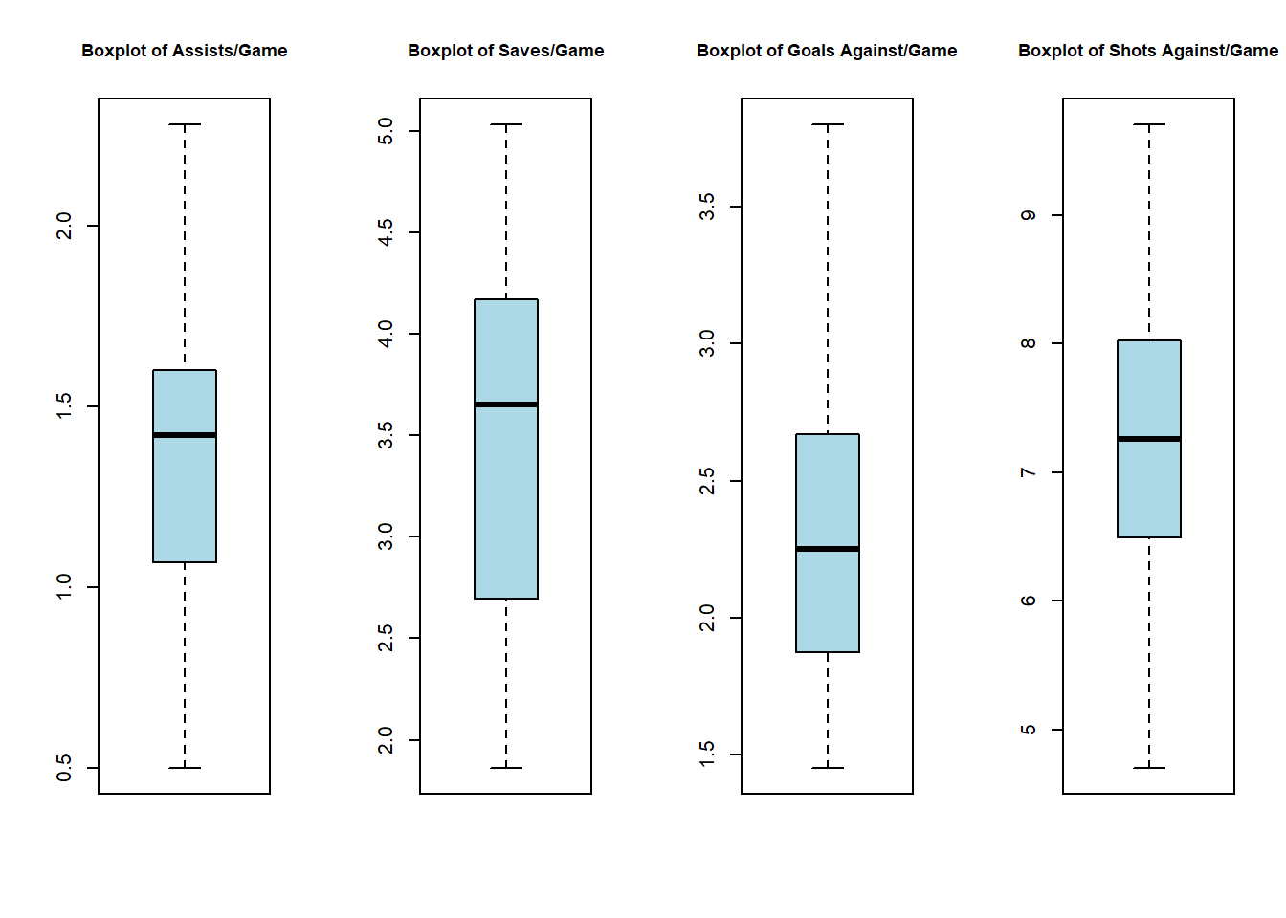
Variable Distribution (BoxPlot)
Little evidence of significant outliers:
Largest outlier (Save Percentage) is still a realistic result
Notes:
Caaden

Slide 9
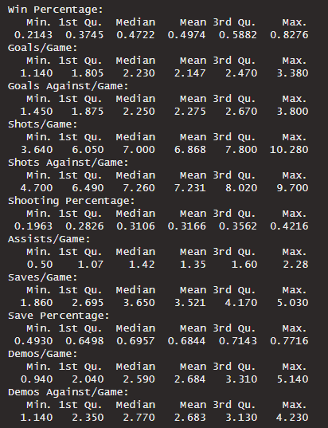
Variable Distribution (Numerical)
Key Values:
Win Percentage Range: (21.4% - 82.8%)
Large Range in Shots/Game: (3.6 – 10.3)
Shooting Percentage Range: (19.6% - 42.1%)
Save Percentage Range: (49.3% - 77.2%)
Notes:
Caaden

Slide 10
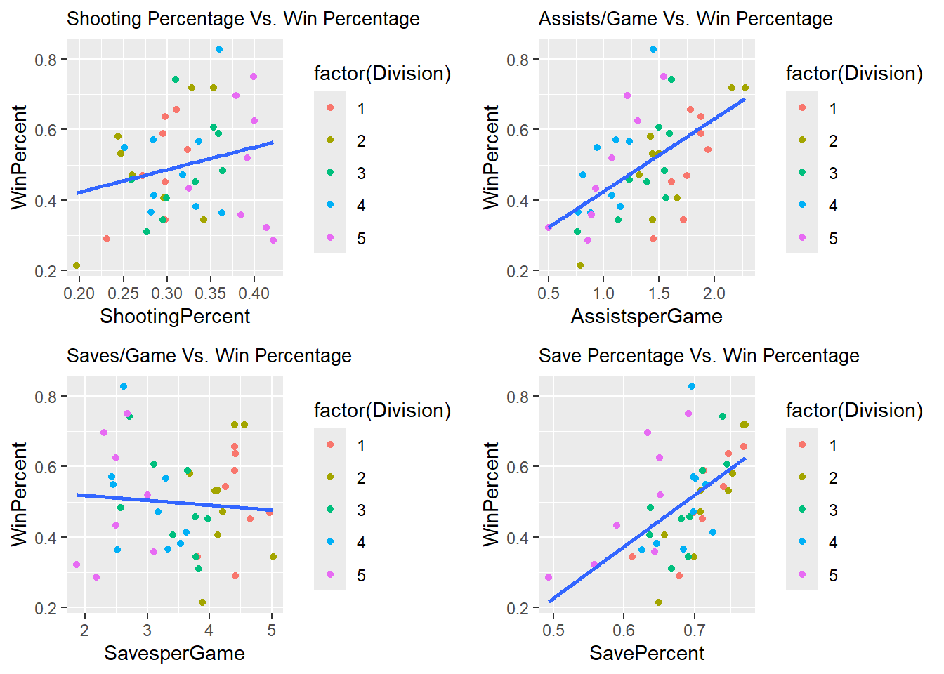
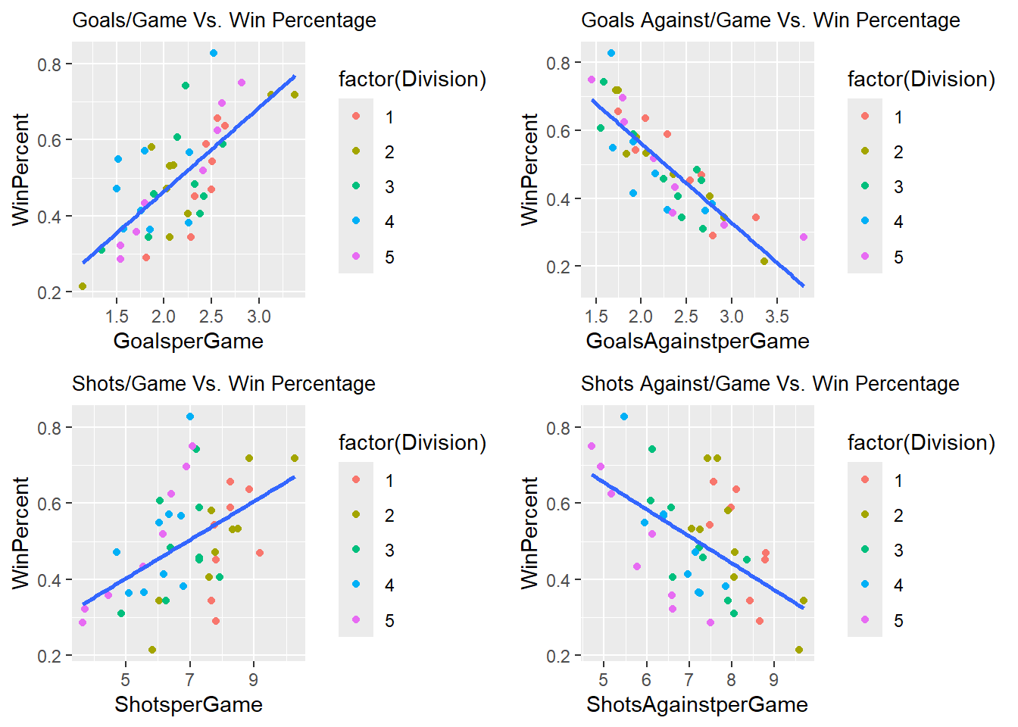
Simple Linear Regression
Notes:
Begin to see some correlation. Will be addressed further later with computational approach

Slide 11
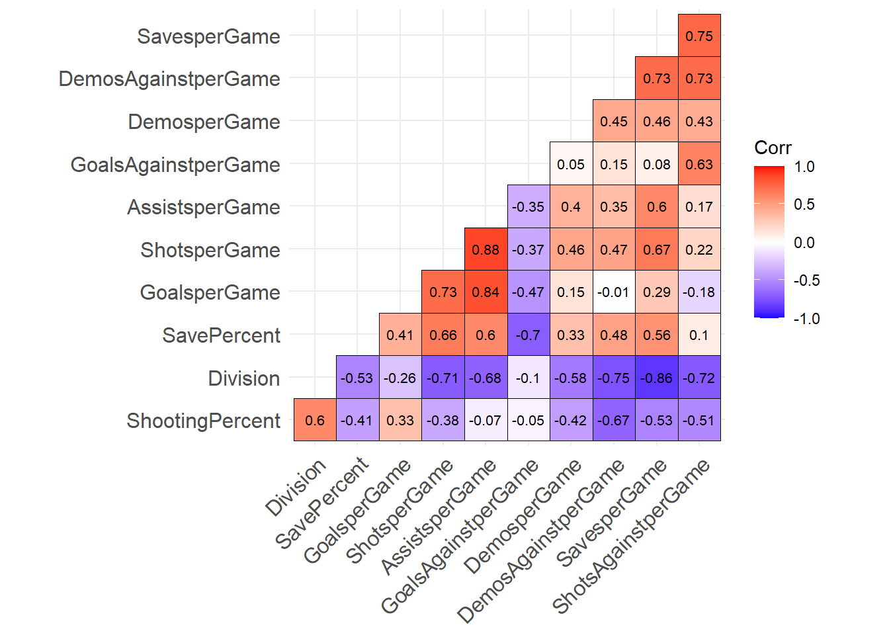
Data Cleaning and Multicollinearity
Data Cleaning:
No missing values in the data
No data dropped
Multicollinearity:
Correlation matrix suggests Assists/Game may have problematic relationships
Assists/Game ~ Assists/Game = 0.88
Assists/Game ~ Goals/Game = 0.84
Assists/Game was dropped for inferences and kept for predictive model
Notes:
No missing values = no dropped data. Multicollinearity = no inferences from prediction model (Can still use to predict)

Slide 12
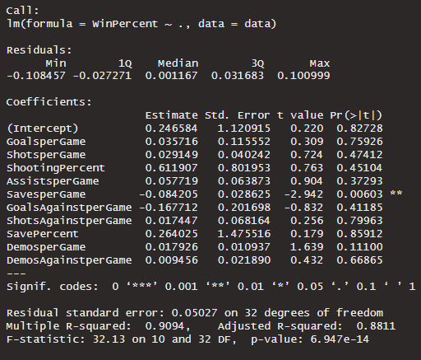
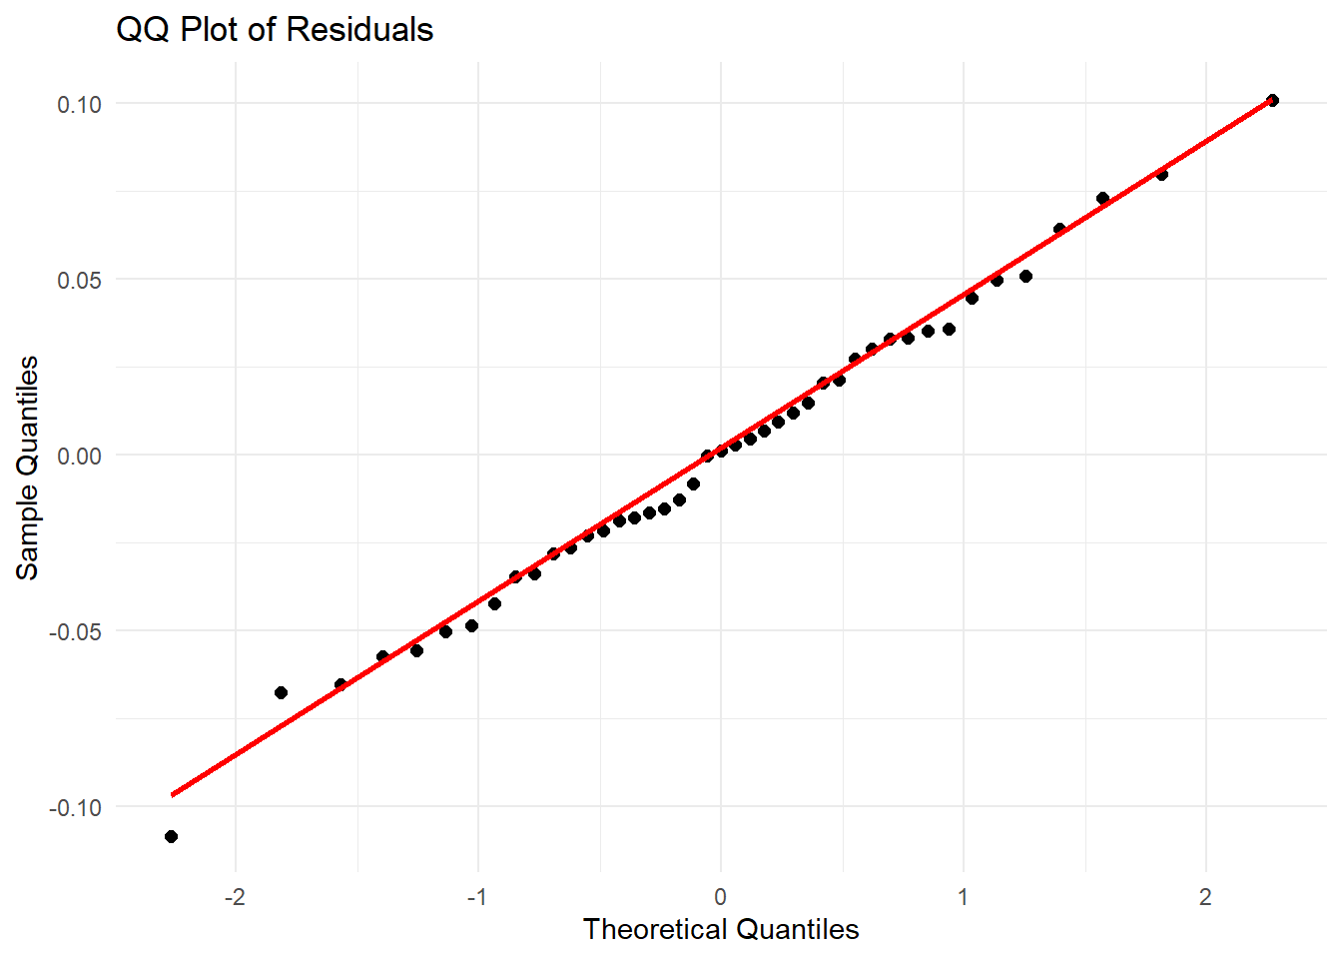
Regression Modeling (Full Prediction Model)
Observations:
High R-Square and Adj. R-Square Values
p-value = 0.000 < 0.05
Low Standard Error
Conclusion:
Good starting model
Risk of overfitting
Notes:
Caaden

Slide 13
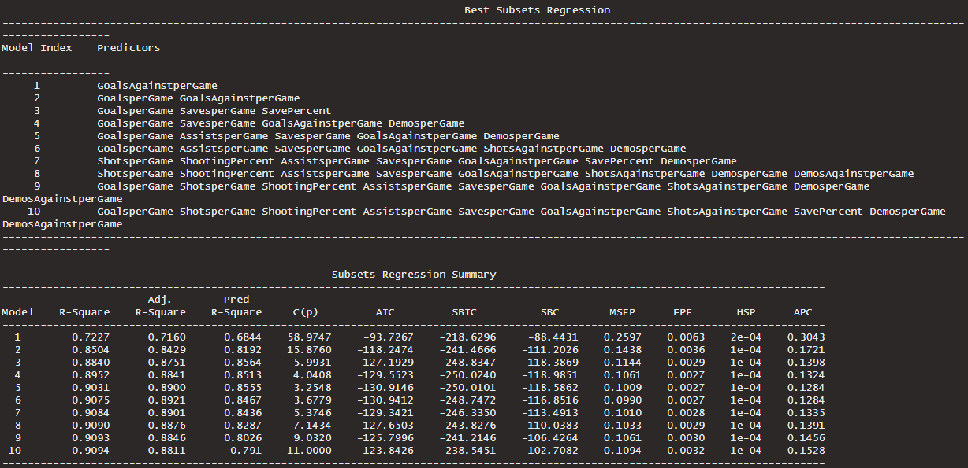
Regression Modelling (Stepwise Selection)
Notes:
Caaden

Slide 14
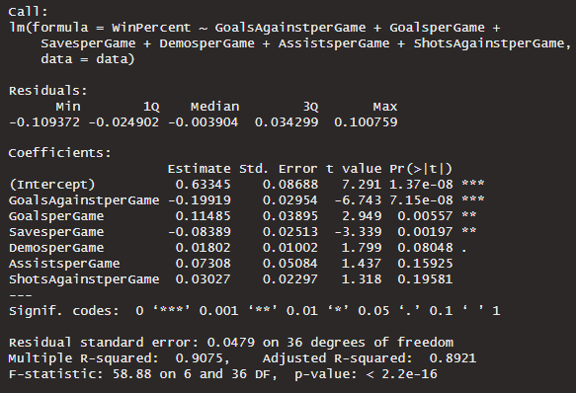
Regression Modelling (Reduced Prediction Model)
Observations:
p-value = 0.000 < 0.05
Improvement in R-Square and Adj. R-Square
Improvement in standard error
Conclusion:
Improvement from full model
Reduces the risk of overfitting
Inferences cannot be made on explanatory variables due to multicollinearity from Assists/Game
Can still use to predict response variable (WinPercent)
Notes:
P-value = Significant. Improvement in key statistics. Reduce risk of overfitting. Cannot be used for inference.

Slide 15

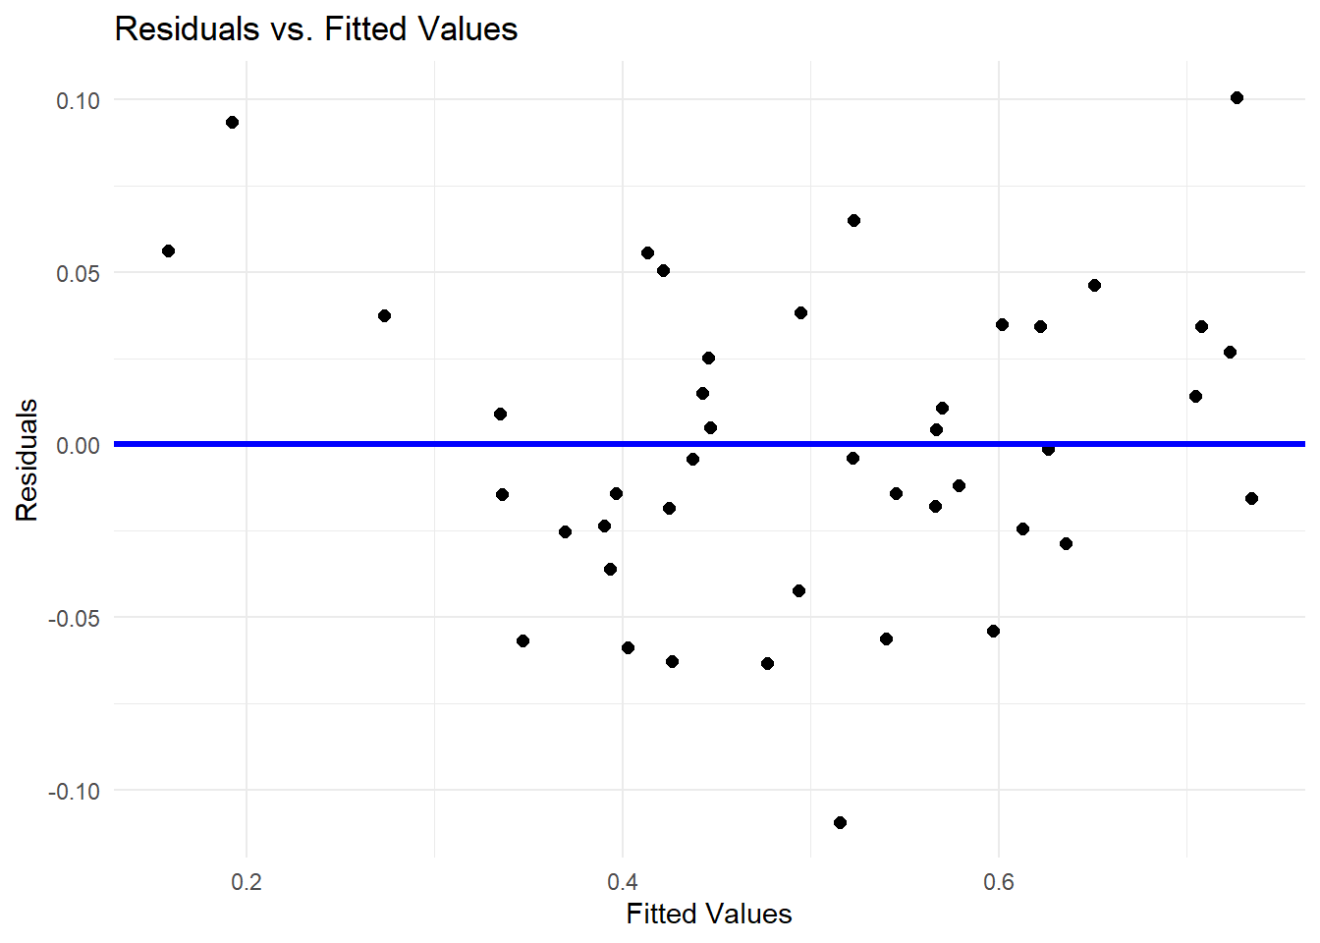
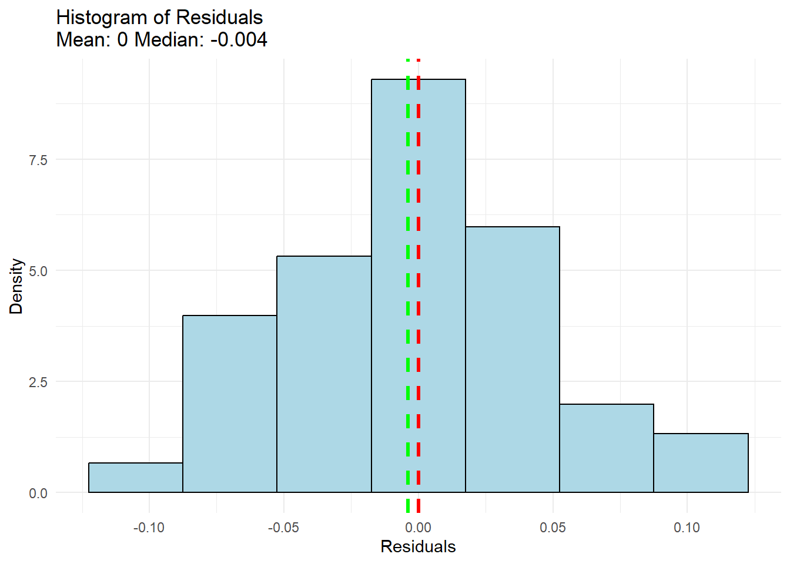
Residual Normality Assumption
Residuals follow an approximately normal distribution
No need for a transformation of the response variable (WinPercent)
Notes:
Residuals approx. normal. No need for transformation of response variable

Slide 16
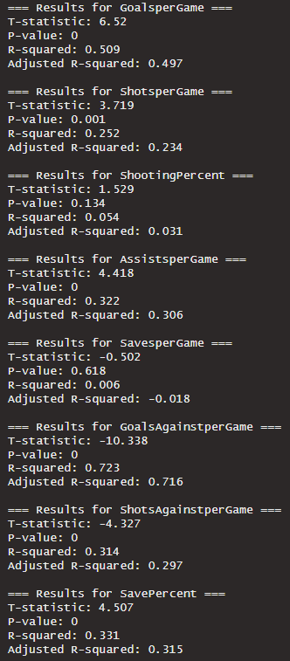
Data Inferences
Method:
Simple Linear Regression Models for each independent variable
Perform hypothesis tests: p < 0.05
Examine R-Squared and adj. R-Squared valued
Conclusions:
Variables with p-value < 0.05 in order of R-Squared relationship
Goals Against/Game (R² = 0.716)
Goals/Game (R² = 0.509)
Save Percentage (R² = 0.331)
Assists/Game (R² = 0.322)
Shots Against/Game (R² = 0.314)
Shots/Game (R² = 0.252)
Relevance:
Positive defensive performance appears to have a greater correlation with win percentage than positive win percentage
Teams should place a higher emphasis on defense and address on offensive efficiency as a secondary focus
Notes:
Found variables with significant correlation. Defensive stats are better correlated. Teams focus on defense.

Slide 17
Limitations
Small Sample Size (n = 43)
Divisional Separation
Playing against lower skilled opponents may lead to win percentage inflation
Multicollinearity Affecting Inferences
Addressed by removing Assists/Game statistic
Unrecorded Performance Statistics
Notes:
Caaden

Slide 18
References
Articles:
Sherman, G. (2024, August 12). Estimating win probabilities of Division I FBS football plays. Sports Innovation Institute. https://blogs.iu.edu/iuindysii/2024/08/12/estimating-win-probabilities-of-division-i-fbs-football-plays/
Rothman, S. (2024, January 31). A New Formula to Predict a Team’s Winning Percentage. Society for American Baseball Research. https://sabr.org/journal/article/a-new-formula-to-predict-a-teams-winning-percentage/
Weiner, J. (2022, July 15). Predicting the outcome of NBA games with Machine Learning. Medium. https://towardsdatascience.com/predicting-the-outcome-of-nba-games-with-machine-learning-a810bb768f20
Data:
Dakota Collegiate Rocket League. (n.d.). https://www.dakotacollegiaterocketleague.com/

Slide 19
Appendix (R Code)
Code was written in R using a R Markdown File and the RStudio IDE. It can be found at the following Source Code link

